Slide 1
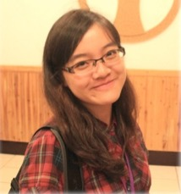
Ying-Jie Wang
Postdoctoral researcher
Ben-Gurion University of The Negev (2023 March - )
Where I am from
Taiwan
Where I received my academic training
KU Leuven, Belgium (PhD)
National Taiwan University, Taiwan (MSc)
National Taiwan Normal University, Taiwan (BSc)

Slide 2
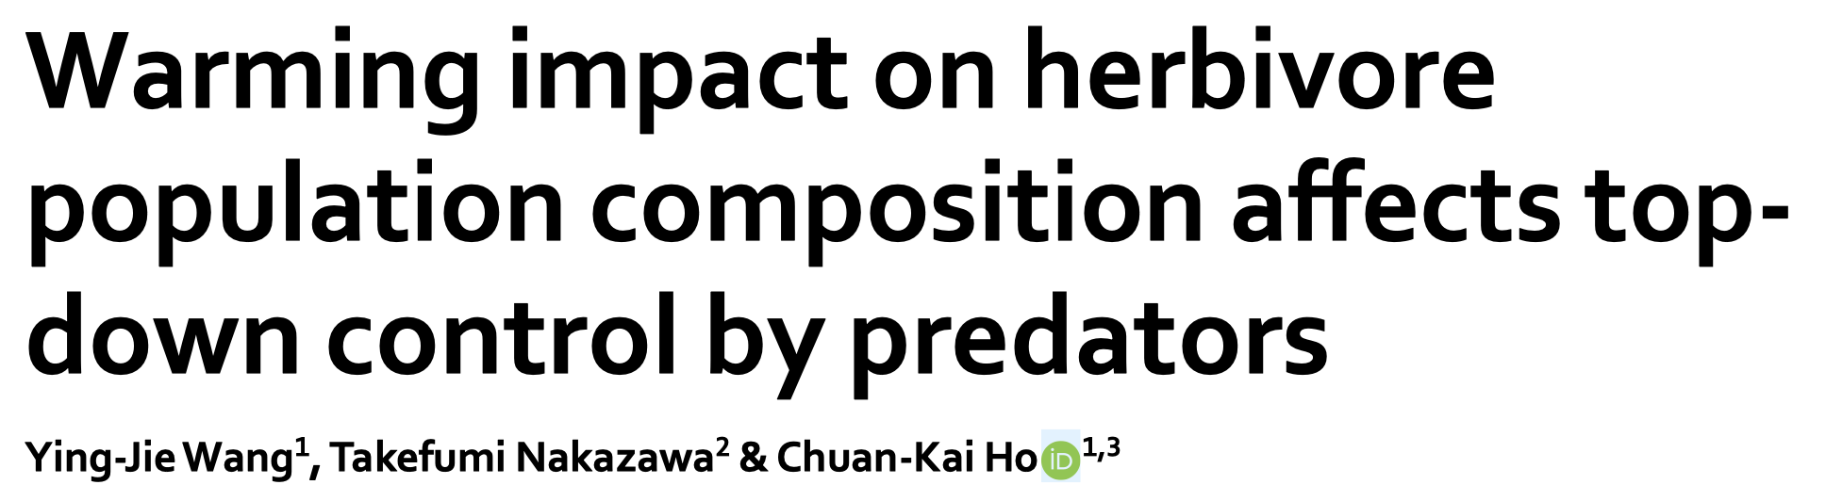
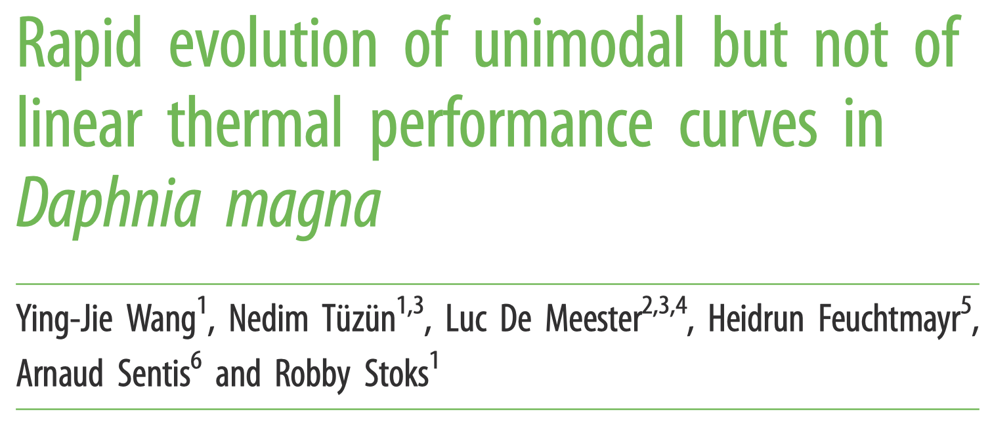
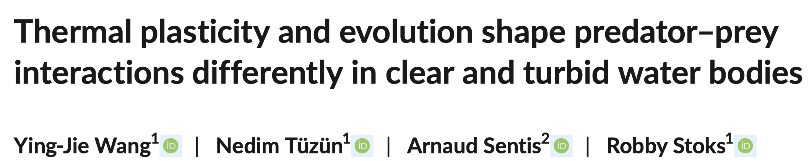
Ying-Jie Wang
Postdoctoral researcher
Ben-Gurion University of The Negev (2023 March - )
What my thesis/research is about
Plasticity & evolution of species & their interactions under global change, as well as their implications on ecosystem stability & functioning.

Slide 3
Ying-Jie Wang
Postdoctoral researcher
Ben-Gurion University of The Negev (2023 March - )
Expertise - What I know
Behavioral ecology, stress ecology, community ecology, evolutionary ecology
(mainly in simplified trophic systems)
Expertise - What I like & want to do
Integrate empirical & theoretical approaches
Expand knowledge & skills in developing theories & modeling
Translating results into high-quality publications
Participate in multi-disciplinary research & collaborations

Slide 4
Ying-Jie Wang
Postdoctoral researcher
Ben-Gurion University of The Negev (2023 March - )
What I want to do in the project
Model eco-evolutionary dynamics of communities
Explore how multilayer networks respond to perturbations (develop theories, integrate theories with experimental results)
What I expect from the project
+ Expertise in theoretical and computational work (ABMs/IBMs, multilayer networks, eco-evolutionary dynamics)
+ Experiences in international & inter-disciplinary collaborations

